Slide 1
Planen for de næste 4 dage
Bog/Hjemmeside
http://www.tutorialsteacher.com/csharp/csharp-tutorials
Denne hjemmeside vil være jeres læsestof, jeg vil supplere med oplæg og opgaver.
Hjemmesiden skal ikke læses fra a-z. I vil i stedet for blevet henvist til hvilken sider i skal læse.
Målet
I skal have dannet jer en en forståelse for de grundlæggende dele i C# og .net
Class, Variable, Data Types, Value types and Reference Types, Keywords, Operators, if-else, Ternary ,Operator, switch, Loops, Array, Collections, Exception, LINQ
Resten af delene i skal lære i C# og .NET vil blive præsenteret i MVC

Slide 2
CTS:
Establish a framework for cross-language execution
Provide an object-oriented model
A set of rules for working with types
CLS: c#, f#, vb, ...
Common Language Specification
Common Type System
Framework Class Library (FCL)
FCL:
A library of functionality to build applications
BCL: is the standard for the C# runtime library and one of the Common Language Infrastructure (CLI) standard libraries. BCL provides types representing the built-in CLI data types, basic file access, collections, custom attributes, formatting, security attributes, I/O streams, string manipulation, and more.
ADO.NET, ASP.NET,
WinForms, Linq, WPF, ...
Base Class Library (BCL)
System. System.Collections, System.Diagnostics, System.Resources, System.Text, ...
CLR:
Memory management
Operating system and hardware independence
Language independence
Common Language Runtime (CLR)

Slide 3
Program
Stack
(local variables go here)
Heap
(instances of classes go here)
i
int i = 100; 0x239110 100
string s = "Hello world" 0x803200 0x600000 0x600000 Hello world
En string opfører sig som en value type, selv om den er en reference type
class User { int id = 1; }
User user = new User(1) 0x906700 0x890000 0x890000 User | id = 1
User user2 = user 0x910000 0x890000
http://www.tutorialsteacher.com/csharp/csharp-value-type-and-reference-type https://www.youtube.com/watch?v=clOUdVDDzIM

Slide 4
Stack
(local variables go here)
Heap
(instances of classes go here)
bool
byte
char
decimal
double
enum
float
int
long
sbyte
short
struct
uint
ulong
ushort
String
All arrays, even if their elements are value types
Class
Delegates
http://www.tutorialsteacher.com/csharp/csharp-value-type-and-reference-type https://www.youtube.com/watch?v=clOUdVDDzIM

Slide 5
The Pillars
For at blive objektorienteret, er et sprog designet omkring begrebet objekter. Det er noget, som har visse egenskaber og udviser visse adfærd. Det betyder, at sproget generelt understøtter:
Encapsulation
Skjule kompleksiteten af de indre funktioner af objektet.
Inheritance
Gør det muligt at oprette nye klasser som kan genbruge, udvide og ændre adfærd, der er defineret i andre klasser.
Polymorphism
mange former
nedarvning gør at objektet kan skifte form
Notes:
Polymorphism - http://csharp-station.com/Tutorial/CSharp/Lesson09

Slide 6
Access Modifiers
public
The type or member can be accessed by any other code in the same assembly or another assembly that references it.
private
The type or member can only be accessed by code in the same class or struct.
protected
The type or member can only be accessed by code in the same class or struct, or in a derived class.
internal
The type or member can be accessed by any code in the same assembly, but not from another assembly.
protected internal
The type or member can be accessed by any code in the same assembly, or by any derived class in another assembly.
https://www.codeproject.com/Articles/1040492/Access-Modifiers-in-Csharp-NET-with-Examples

Slide 7
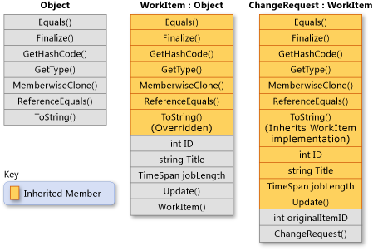
Inheritance
Inheritance giver dig mulighed for at oprette nye classes, genbruge, udvide og ændre adfærd, der er defineret i andre klasser. Classen hvis medlemmer er nedarvet kaldes Basis Class, og den klasse, der arver de medlemmer kaldes den derived class.
Kan kun have en base class.
Kan implementere utallige antal interfaces

Slide 8
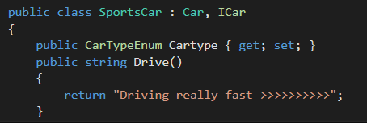
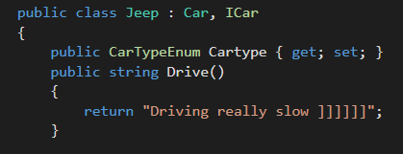
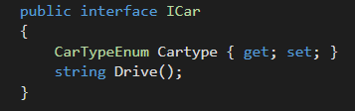
Interface
Et interface indeholder kun signaturer for methods, properties, events or indexers. En classe eller struct, der implementerer interface skal implementere medlemmerne af interface, der er angivet i grænsefladen definition.
Må ikke indeholde fields
Kan ikke lave en ny instance (new ICar)
Naming Convention: Skal starte med I

